Slide 1



Onboarding

Slide 2

Table of Contents
1
Content overview
2
How to easily leverage our Toolkits to create your own deliverables
3
How to easily translate our Toolkits in all languages

Slide 3


Aurelien Domont
Domont Consulting CEO
Ex-Deloitte Management Consultant
Our Story
"Imagine having a team of ex-McKinsey, Deloitte and BCG Management Consultants at your disposal 24/7 to help you solve your business problems and improve the growth and efficiency of your organization. How much more confident would you be about the future performance of your organization and your own career progression? How much time could you save?
If you have ever tried solving business problems that you haven’t encountered before, you know how frustrating it can be to start from scratch. And even then, you still aren’t sure if what you’re doing is going to end up wasting your time and money. Having someone by your side who has already solved these business problems would be a huge help. That’s why businesses hire management consultants for support in the first place.
The only problem is that hiring a couple of tier-1 Consultants for a project can cost upwards of $300,000, a price many businesses simply can’t afford.
I wanted to do something about this because I believe everyone deserves high-value business guidance, regardless of their budget!
That’s why in 2012, I teamed up with other ex-McKinsey, Deloitte and BCG Consultants to create comprehensive Management Consulting Toolkits designed to solve your business problems and improve the growth and efficiency of your organization!
Whether you're an executive, entrepreneur or consultant from a small or large organization, you can now leverage the know-how and best practices of our ex-McKinsey, Deloitte & BCG Management Consultants without breaking your budget.
And for those with a higher budget seeking additional support on top of our Toolkits, our tier-1 management consultants (ex-McKinsey, Deloitte, BCG) are available for hire all around the world. You will find our daily rates to be significantly more affordable than traditional tier-1 consulting firms, thanks to our innovative business model with minimal overhead.
After humble beginnings, we are now proud to have supported 200,000+ executives, consultants, and entrepreneurs from small and large organizations, in more than 180 countries."

Slide 4



















Our ex-McKinsey, Deloitte & BCG Management Consultants and JP Morgan Investment Bankers have created 20 Toolkits
1. Corporate/Business Strategy and Strategic Planning Toolkit
2. Operating Model & Organization Design Toolkit
3. Digital Transformation and IT Strategy Toolkit
4. Program, Project and Change Management Toolkit
5. Management Consulting Toolkit
6. Human Resources & Talent Management Toolkit
7. Mergers & Acquisitions Toolkit
8. Post Merger Integration Toolkit
9. Sales, Marketing, Pricing & Communication Strategy Toolkit
10. Business Plan & Entrepreneurship Toolkit
11. Supply Chain Strategy Toolkit
12. Lean 6 Sigma Toolkit
13. Risk Management Toolkit
14. Business Case Toolkit
15. Executive Dashboard Toolkit
16. Leadership Development Toolkit
17. Financial Modeling, Planning & Analysis Toolkit
18. Customer Experience Strategy & Design Thinking Toolkit
19. Data Analytics and AI Strategy Toolkit
20. Personal Finance & Warren Buffett Investing Strategy Toolkit
Need another Toolkit? Let us know by sending an email at support@domontconsulting.com

Slide 5












Toolkits overview
What’s inside our Toolkits?
Who created our Toolkits?
Our Toolkits were created by ex-McKinsey, Deloitte & BCG Management Consultants, and JP Morgan Investment Bankers.
Best Practices
Frameworks
Number of professionals leveraging our Toolkits
Advice from
tier-1 Management Consultants
Tools
There are 200,000+ Executives, Consultants & Entrepreneurs leveraging our Toolkits to improve the performance of their organization
Real-life Examples
Templates
Trusted by small and large organizations
Video Training
Step-by-step Tutorials

Slide 6









Our Management Consulting Toolkits include 9 key benefits
Improve the growth & efficiency of your organization by leveraging Management Consulting Toolkits created by ex-McKinsey, Deloitte & BCG Consultants.
Make a great investment for your career & organization. It cost us US$8M+ over the past 10 years to create all our Toolkits. Get them for a fraction of this cost.
Get a competitive advantage. It’s like hiring Management Consultants to create all the practical Frameworks, Tools & Templates you need.
Get the job done quicker and never start from scratch again with our ready-made and fully editable Frameworks, Tools & Templates in Powerpoint & Excel.
Don't reinvent the wheel. We have already worked 30,000+ hours over the past 10 years to create all the Management Consulting Toolkits you need.
Improve the capabilities of your organization by learning how the Fortune 100 and Global Consulting Firms do it.
Decrease your costs. Hiring tier-1 Consultants for a project would cost you $300k+. Way more expensive than our Toolkits, which will last you a lifetime!
Become your organization’s subject matter expert and impress your stakeholders with world-class approaches to resolve common business problems.
Get free support and advice from our ex-McKinsey, Deloitte & BCG Management Consultants.

Slide 7
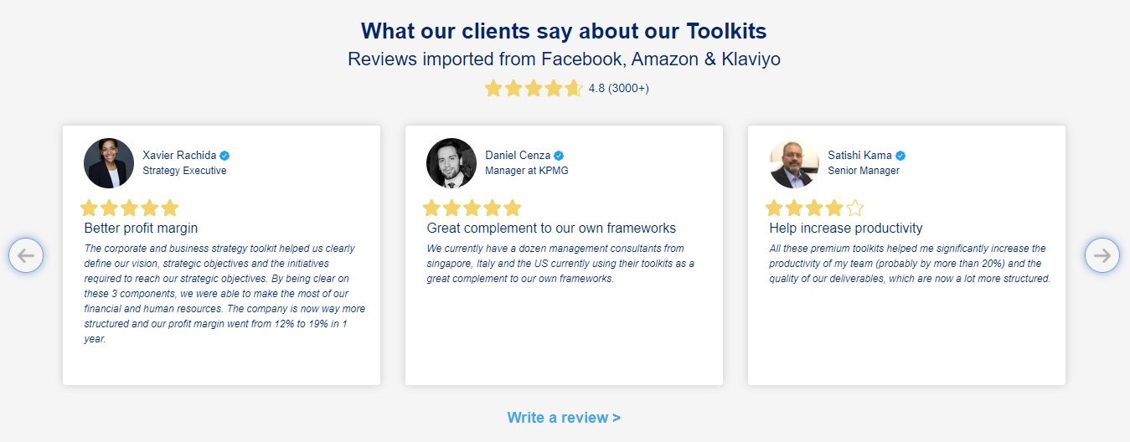
What our clients say about our Toolkits
Click here to see more reviews >

Slide 8

Join 200,000+ Executives, Consultants & Entrepreneurs leveraging our Toolkits to improve the performance of their organization
Trusted by small and large organizations
Customer satisfaction
4.8
Number of countries leveraging our Toolkits
160+
Number of professionals leveraging our Toolkits
200,000+
Daily rate of our ex-McKinsey, Deloitte and BCG Management Consultants
$3k-$4k

Slide 9

Interested in more than 1 Toolkit? Access all our Toolkits for half the price with our Gold Access
Gold Access
Click here to learn more

Slide 10






Need additional help? Send us a brief and we’ll find you the right talent from our network of 500+ tier-1 Management Consultants
Click here to send us a Project Brief

Slide 11
Table of Contents
1
Content overview
2
How to easily leverage our Toolkits to create your own deliverables
3
How to easily translate our Toolkits in all languages

Slide 12
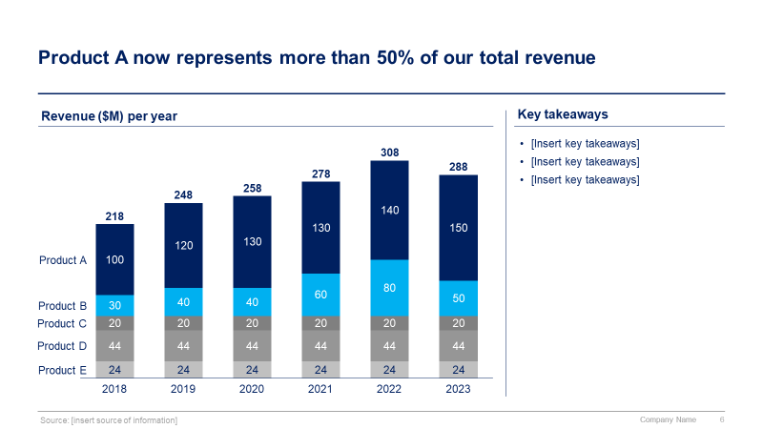
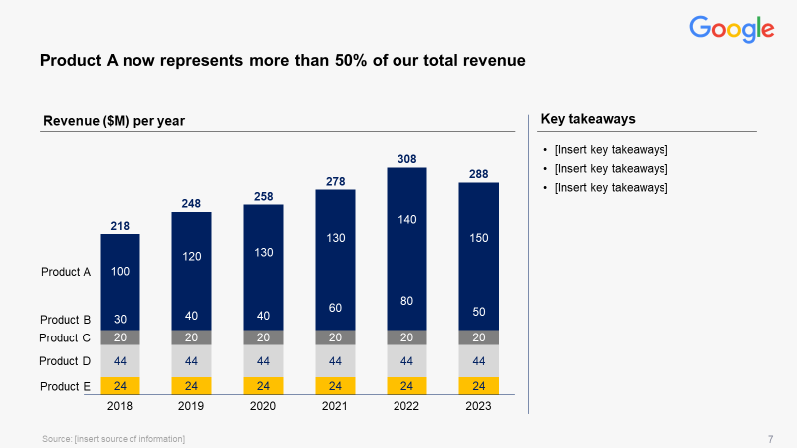
Our ready-made Toolkit is fully editable and can easily be customized to meet the brand guidelines of your organization

Slide 13
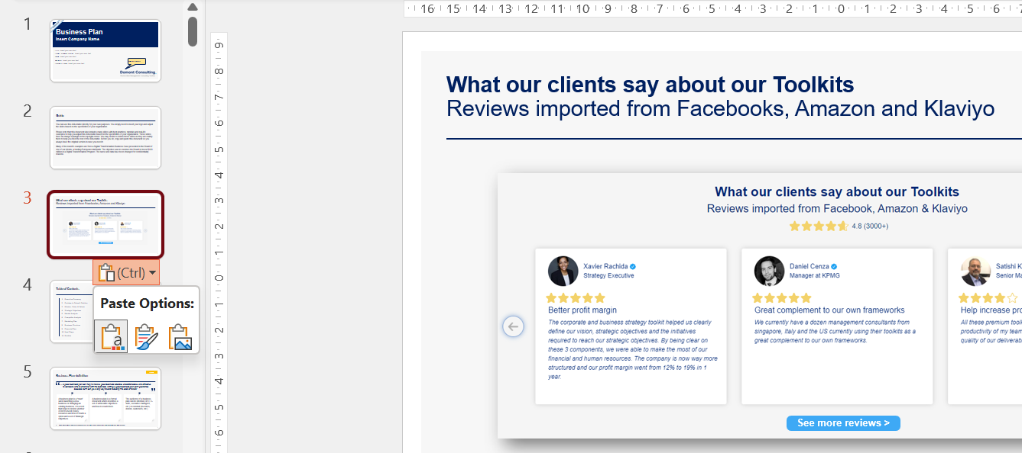
You can change the slide format in a couple of steps
Select the slides you want to copy.
Right-click on your mouse and then select “Copy” (or press CTRL+C if you have a PC).
Paste the slides into your own presentation.
Click on the “Paste Options” drop-down list, which will automatically appear at the bottom of the slides, and select either option 1 (“Use destination theme”) if you want to use your own formatting, or option 2 (“Keep source formatting”) if you want to use our formatting:
Make sure that the pasted slides are using the layout that you want. To do that you simply need to right click on the inserted slide and click on layout, and then select the layout that you want.
“Paste Options” dropdown list

Slide 14
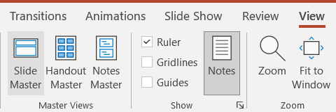
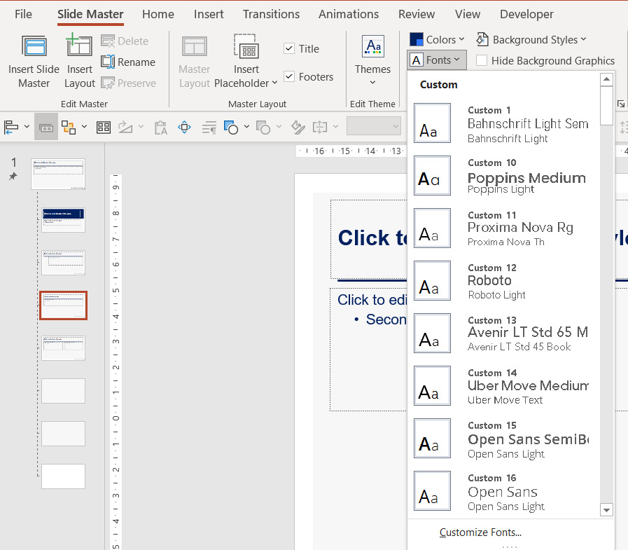
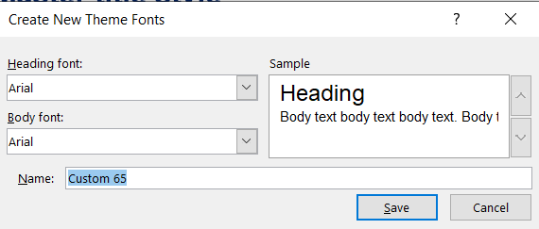
You can change the font type in the Slide Master in 3 steps
1
View → Slide Master
2
Font → Customize Fonts…
3
Enter the preferred font type and Save

Slide 15
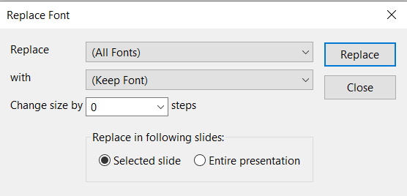
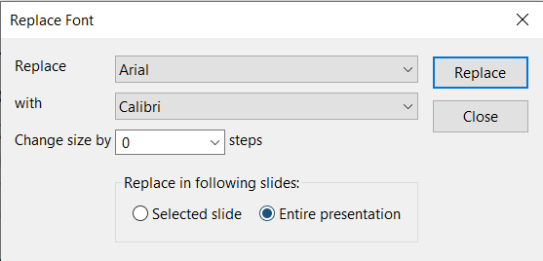
You can also use the “Replace Fonts” option
1
Home → Replace → Replace font
2
Enter the font to be replaced in “Replace” and the preferred font type in “with”
3
Click “Entire presentation” to change the font in the entire document and click Replace

Slide 16
Table of Contents
1
Content overview
2
How to easily leverage our Toolkits to create your own deliverables
3
How to easily translate our Toolkits in all languages

Slide 17


To instantly translate our Toolkits, our clients usually choose the world’s best AI translators in the world: Deepl Translator or Microsoft Translator
Deepl Translator
Microsoft Translator
With Deepl Translator, you can easily and instantly translate an entire document in 30+ languages. All you need to do is go on their website https://www.deepl.com/translator, and drag and drop your Powerpoint or Word document.
We indirectly pay for Deepl.com by providing you a US $50 discount, which you can use to purchase our Toolkits. This discount will cover the cost of Deepl.com. To get this US $50 discount, enter this discount code at checkout: DEEPL$50DISC
With Microsoft Translator, you can easily and instantly translate our Toolkits in all languages.
Microsoft Translator is free and directly available within Powerpoint and Excel.
It uses Neural Machine Translation (NMT), which is the new standard for high-quality AI-powered machine translations.

Slide 18
Let’s first zoom on Deepl Translator
Deepl Translator
Microsoft Translator
With Deepl Translator, you can easily and instantly translate an entire document in 30+ languages. All you need to do is go on their website https://www.deepl.com/translator, and drag and drop your Powerpoint or Word document.
We indirectly pay for Deepl.com by providing you a US $50 discount, which you can use to purchase our Toolkits. This discount will cover the cost of Deepl.com. To get this US $50 discount, enter this discount code at checkout: DEEPL$50DISC
With Microsoft Translator, you can easily and instantly translate our Toolkits in all languages.
Microsoft Translator is free and directly available within Powerpoint and Excel.
It uses Neural Machine Translation (NMT), which is the new standard for high-quality AI-powered machine translations.

Slide 19
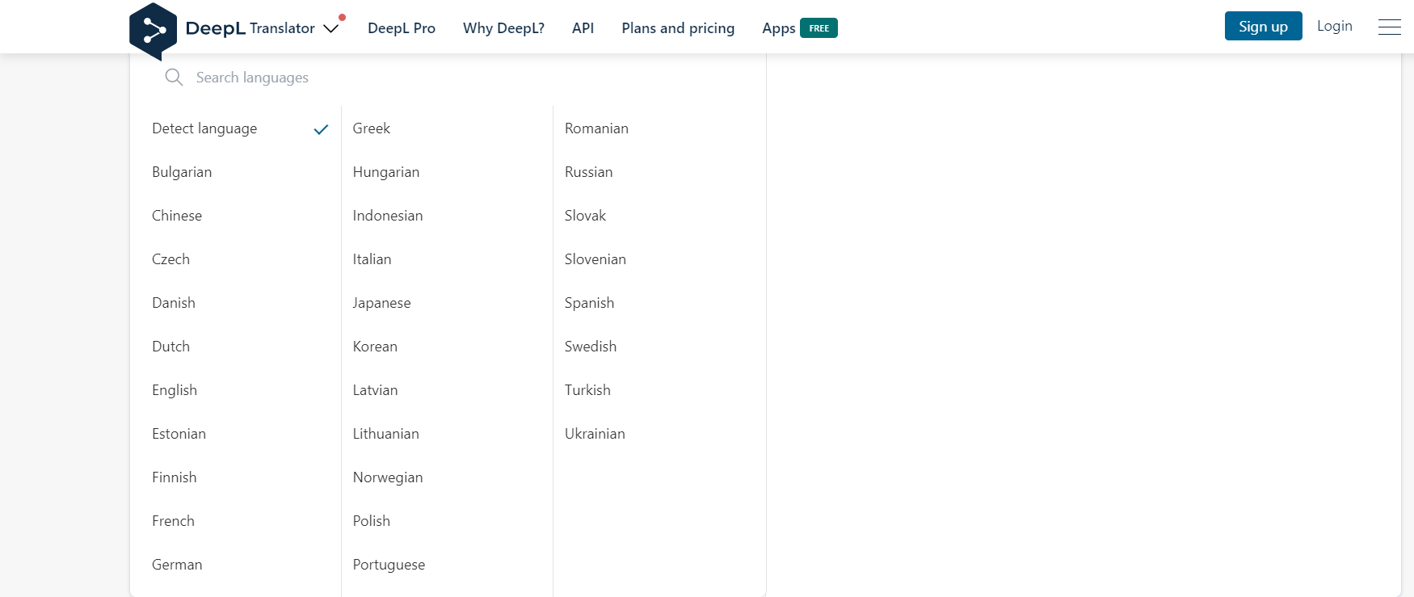
You can translate our Toolkits into 30+ languages using Deepl Translator

Slide 20
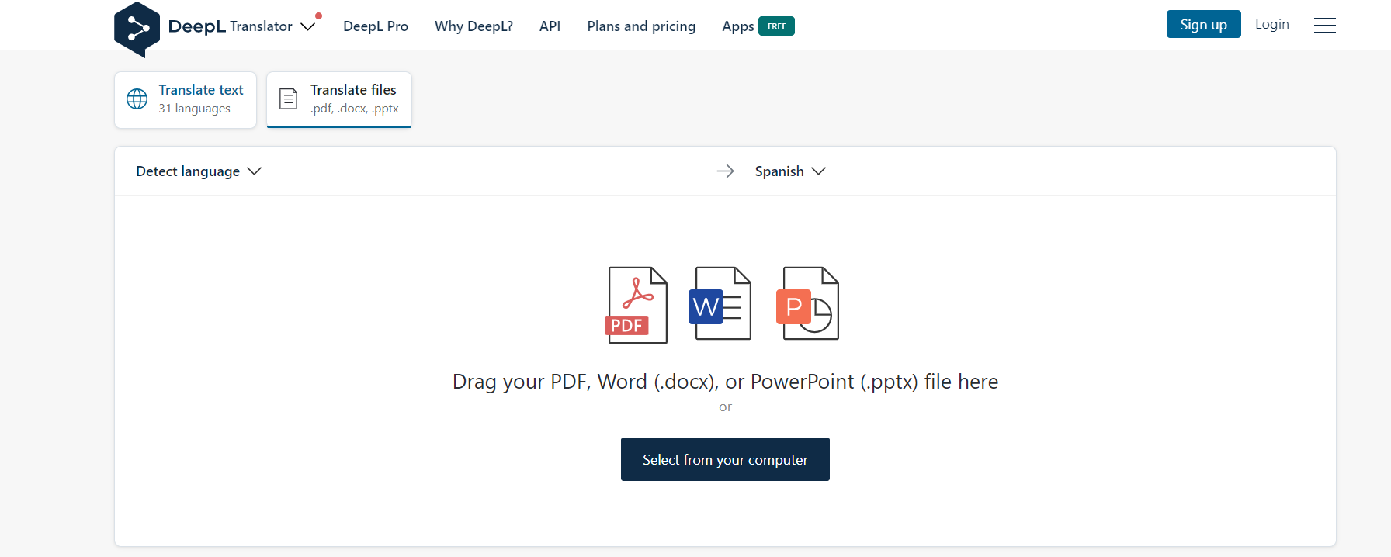
All you need to do is drag and drop your Powerpoint, Word or PDF document

Slide 21
Let’s now zoom on Microsoft Translator
Deepl Translator
Microsoft Translator
With Deepl Translator, you can easily and instantly translate an entire document in 30+ languages. All you need to do is go on their website https://www.deepl.com/translator, and drag and drop your Powerpoint or Word document.
We indirectly pay for Deepl.com by providing you a US $50 discount, which you can use to purchase our Toolkits. This discount will cover the cost of Deepl.com. To get this US $50 discount, enter this discount code at checkout: DEEPL$50DISC
With Microsoft Translator, you can easily and instantly translate our Toolkits in all languages.
Microsoft Translator is free and directly available within Powerpoint and Excel.
It uses Neural Machine Translation (NMT), which is the new standard for high-quality AI-powered machine translations.

Slide 22
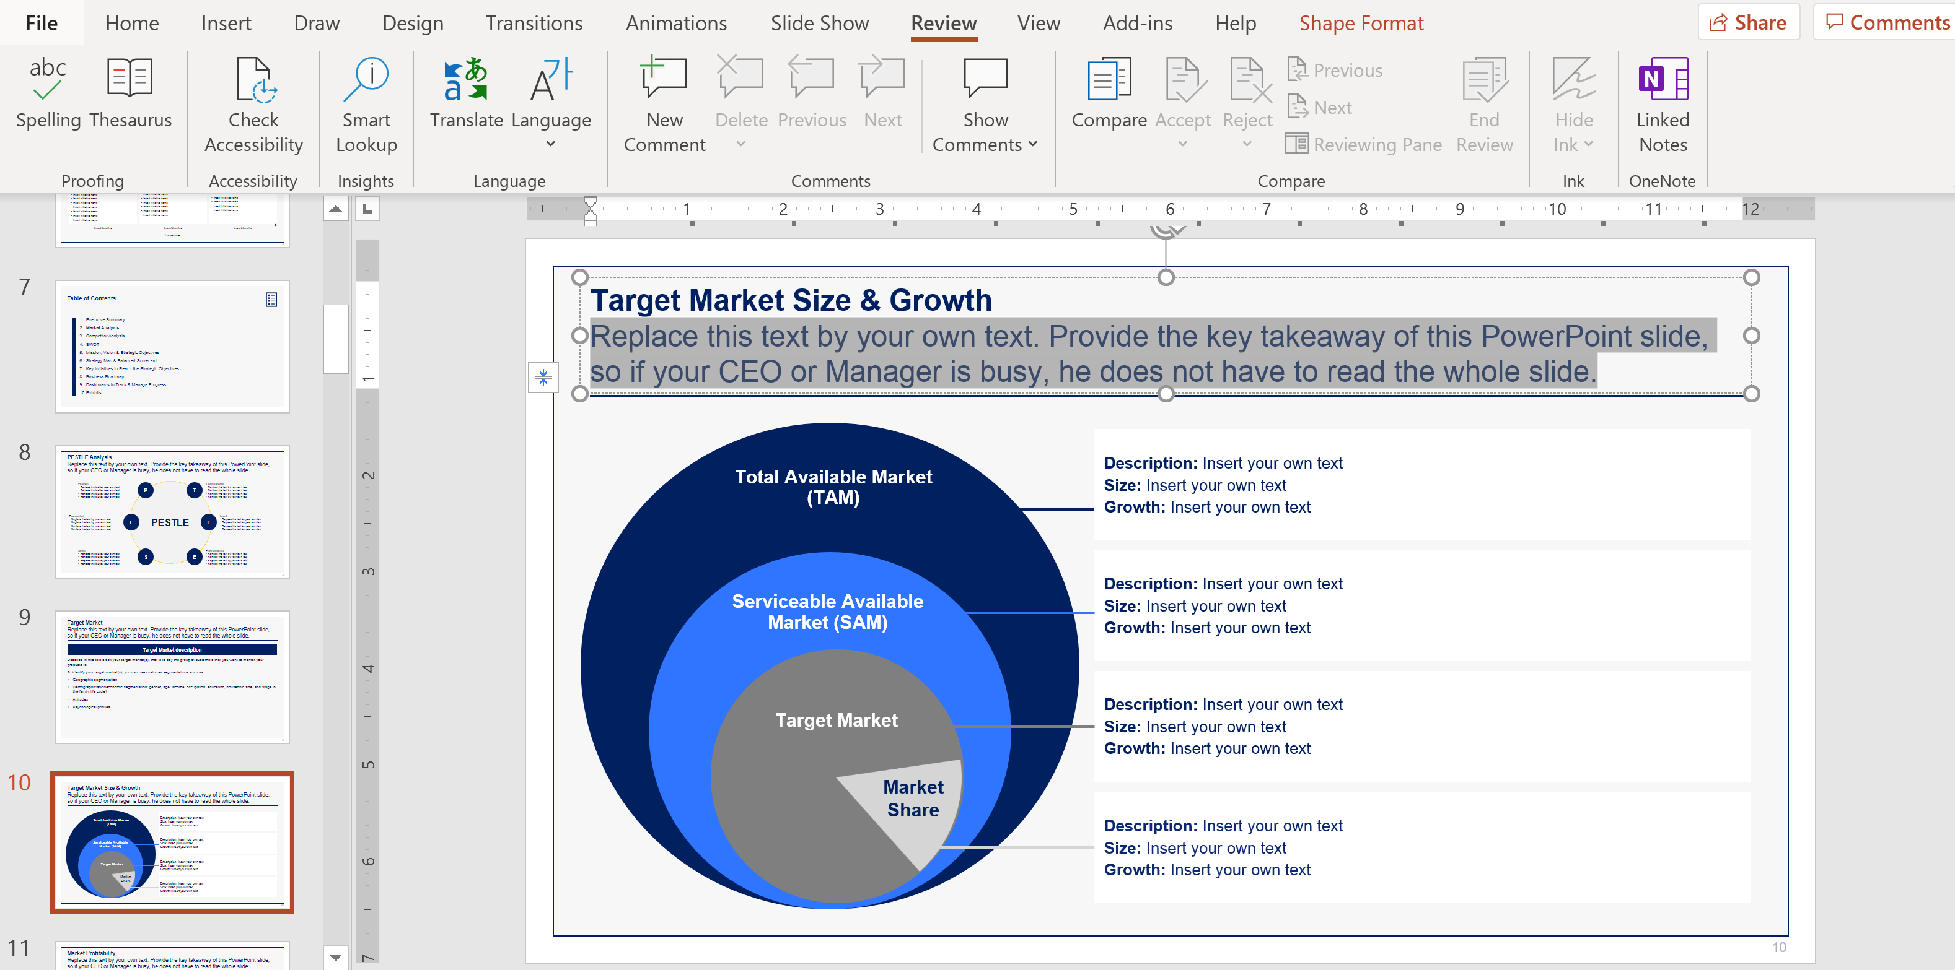
How to translate the Powerpoint version of our Toolkit Step 1
1
Open your Powerpoint document, select the text you want to translate and click on the “Review” tab

Slide 23
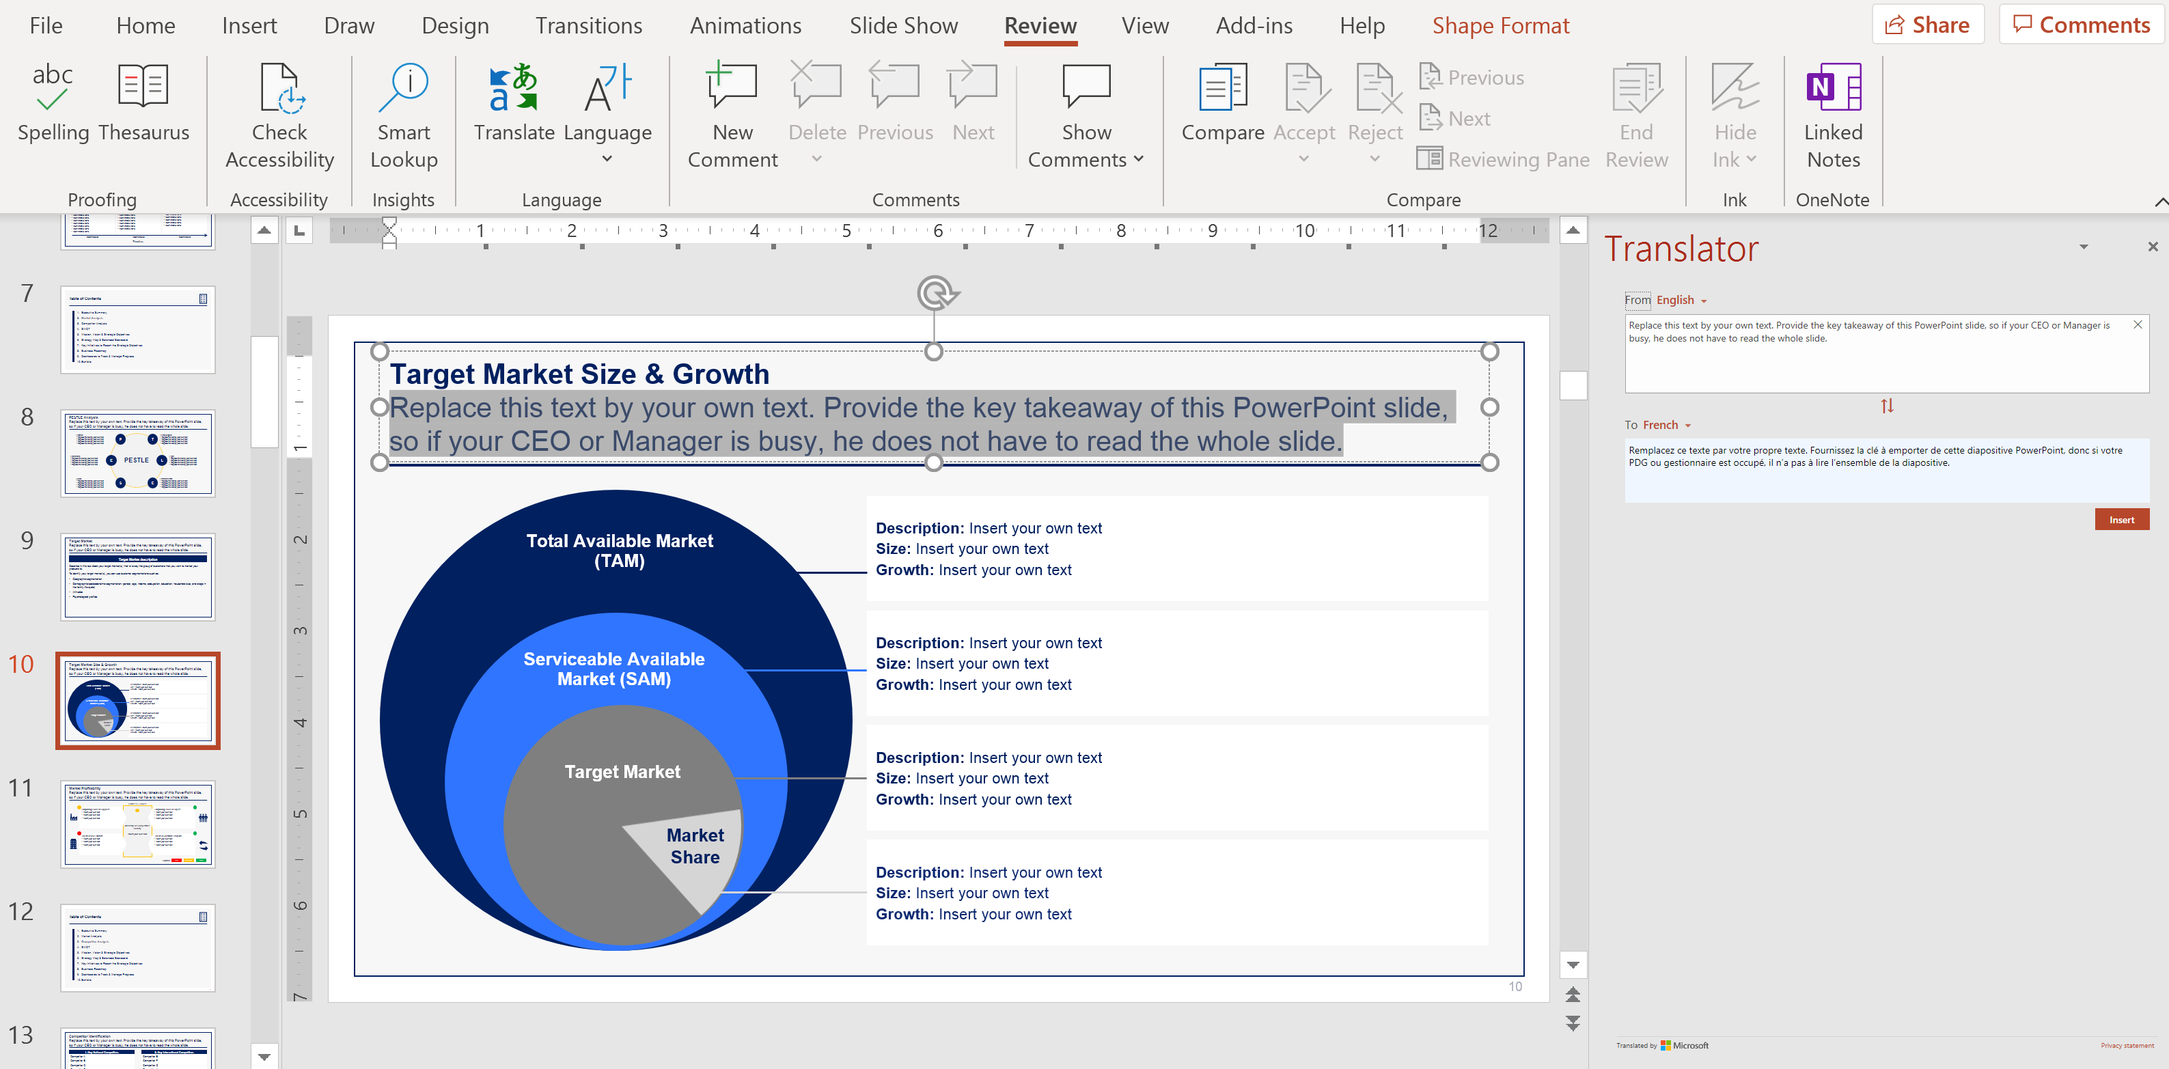
How to translate the Powerpoint version of our Toolkit Step 2
2
Click on “Translate”

Slide 24
How to translate the Powerpoint version of our Toolkit Step 3
3
Select the language you want the text to be translated into

Slide 25
How to translate the Powerpoint version of our Toolkit Step 1
4
Click “Insert” to replace the initial text with the translated text.

Slide 26
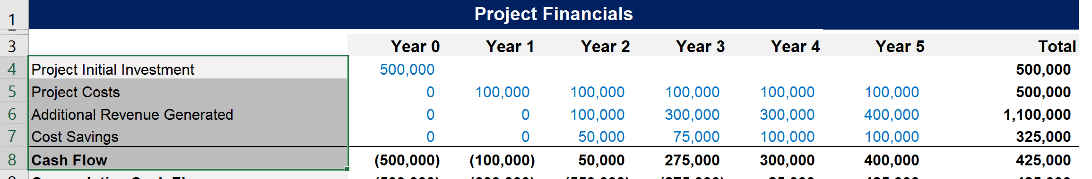
How to translate the Excel version of our Toolkit Step 1
1
Open your Excel document and select 1 cell or multiple cells in the same column

Slide 27
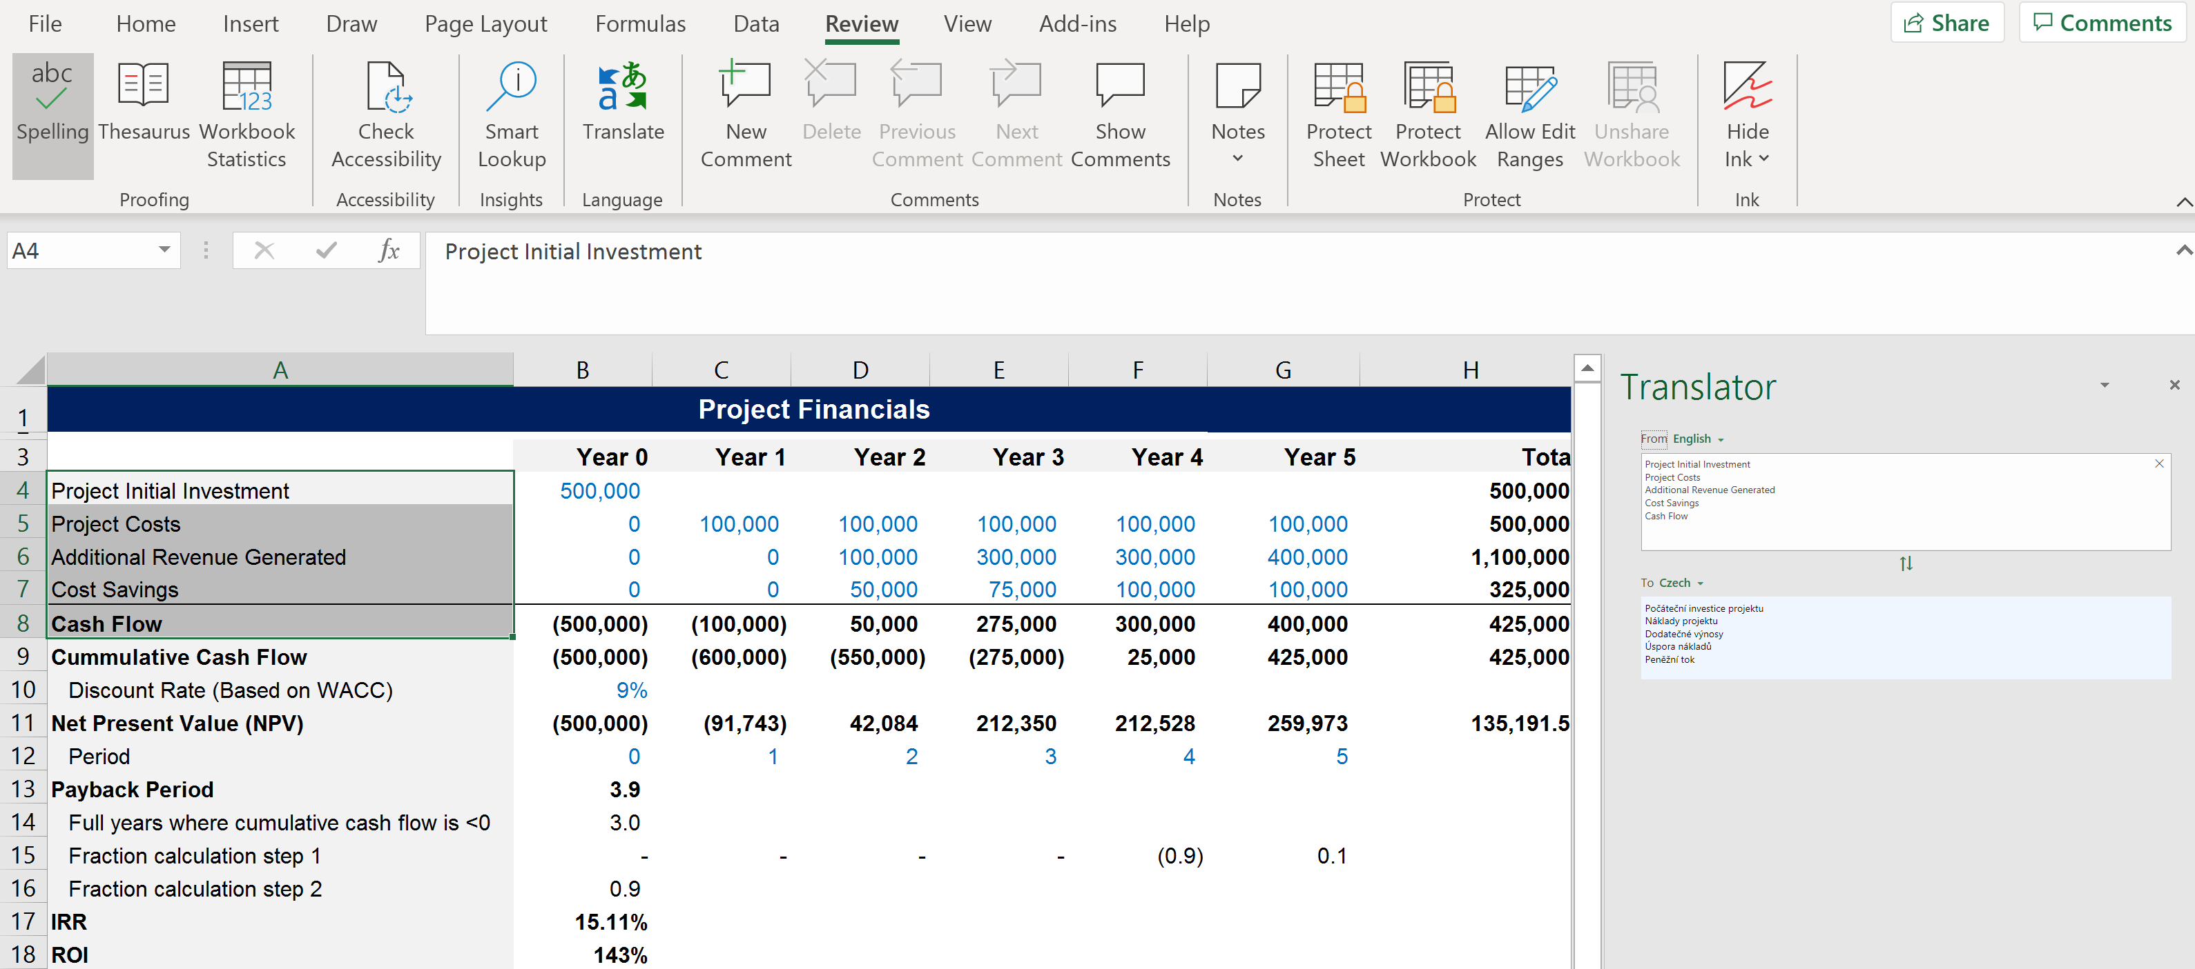
How to translate the Excel version of our Toolkit Step 2
2
Click on the “Review” tab and then “Translate”.

Slide 28
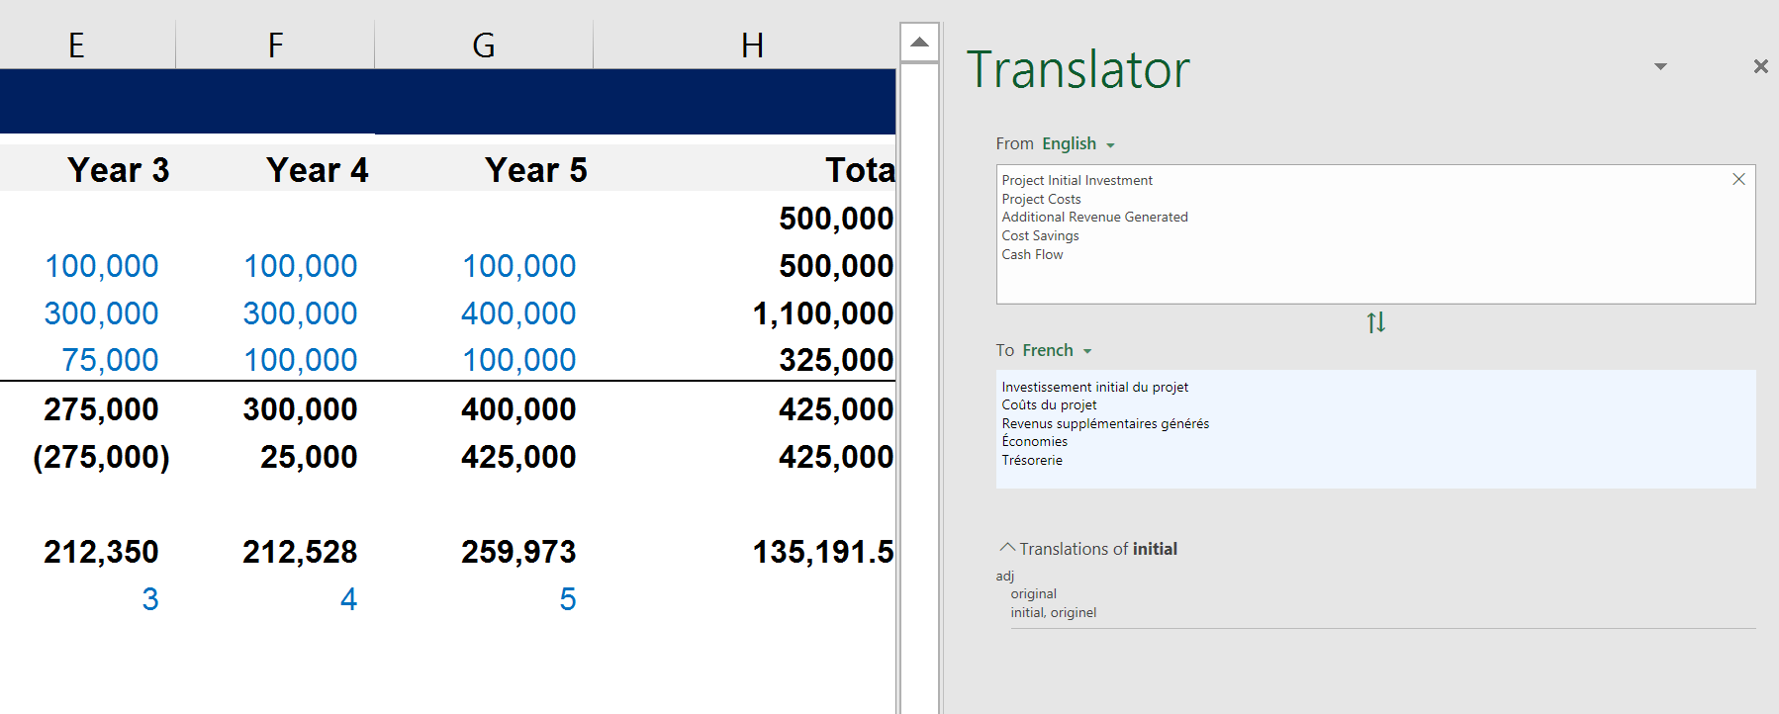
How to translate the Excel version of our Toolkit Step 3
3
Click inside the translated box and then select CTRL+A to select the entire translation, and CTRL+C to copy it

Slide 29
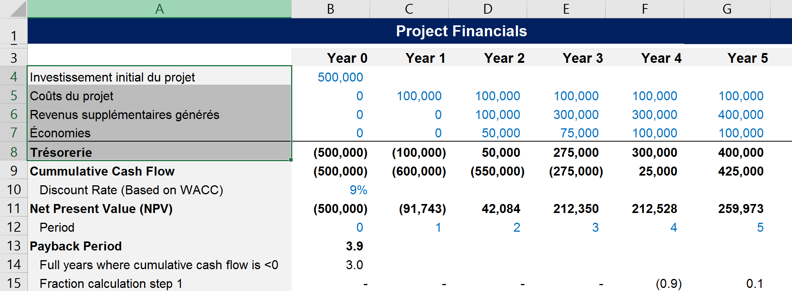
How to translate the Excel version of our Toolkit Step 4
4
Select where you want to paste your translation (in the example below, we decided to paste it exactly where the initial English text was). Then click on “Paste”, “Paste special” and “Text”. The 1 cell or multiple cells from the same column will be pasted using the same initial formatting

Slide 30
Thank you for your attention.
www.domontconsulting.com

